Slide 1

Building Testing Dropboxes

Slide 2
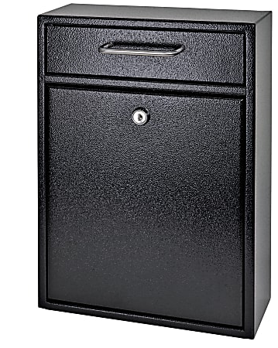
DROPBOXES
^^^^^^^^^^^^^^^ ^^^^^^^^ ^^^^^^^^ ^^^^^^^^ ^^^^^^^^ ^^^^^^^^ ^
^^^^^^^^^^^^^^^ ^^^^^^^^ ^^^^^^^^ ^^^^^^^^ ^^^^^^^^ ^^^^^^^^ ^
Wait, who are you again? Am I even in the right talk?
What are you talking about?
What’s even the point? (I mean, really?)
Deposit Hacks Here!
Christopher Carlis
Red Teamer / Penetration Tester / Offensive Security Person

Slide 3

You’re going to have to make some decisions.
Not so much a talk with answers as a talk with a bunch of extra questions…

Slide 4
Things we’ll cover
Testing Goals
Budget
Hardware
Software
Communication
OPSEC
Trying to avoid making new massive mistakes.

Slide 5
PENETRATION TEST vs. RED TEAM
Overkill and Underpowered?!? How did you manage that?

Slide 6
BUDGET CONCERNS
SO, YOU WASTED BOTH YOUR TIME AND MY MONEY?

Slide 7
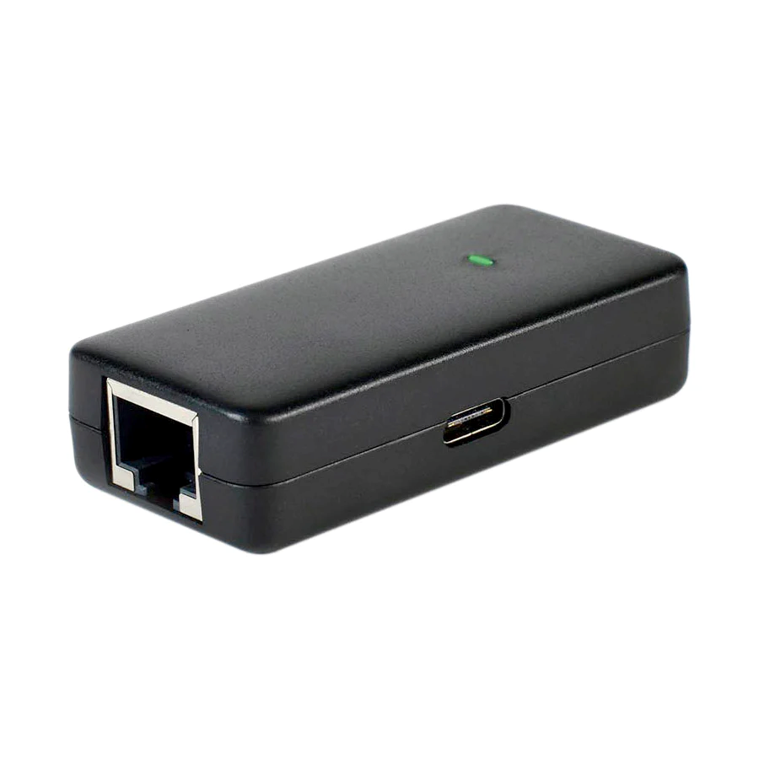
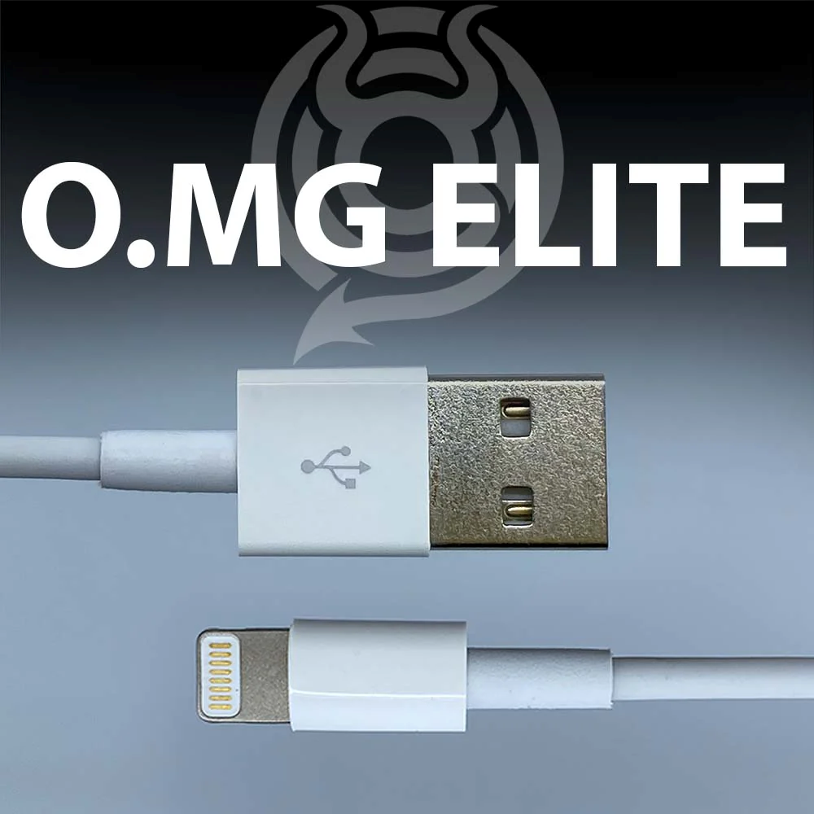
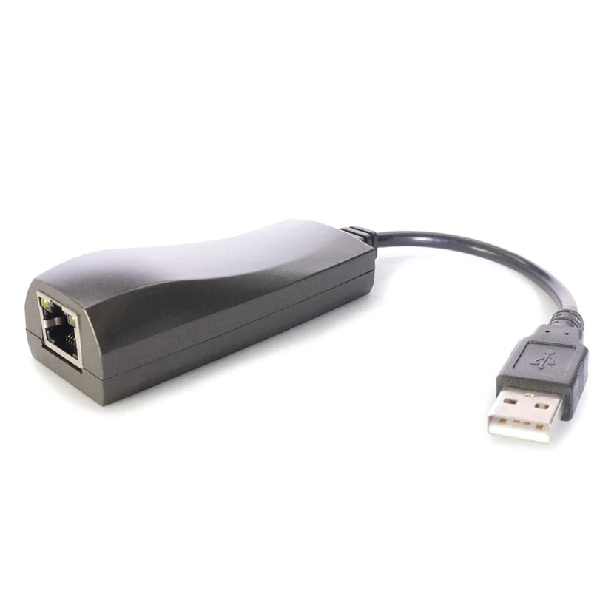
DIY vs. BUY
Why HAK5 doesn’t get all my money.

Slide 8

Hardware Considerations
Size/Shape/Sound/Stuff
Capabilities
Ease of Use
Cost

Slide 9
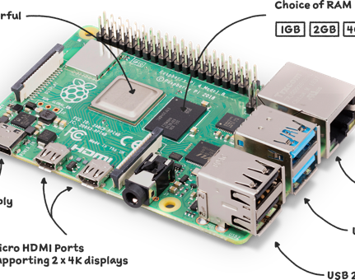
Hardware Considerations
Raspberry Pi:
Cheap
Small / Quiet
Low(ish) Power req.
Has gotten less flakey

Slide 10
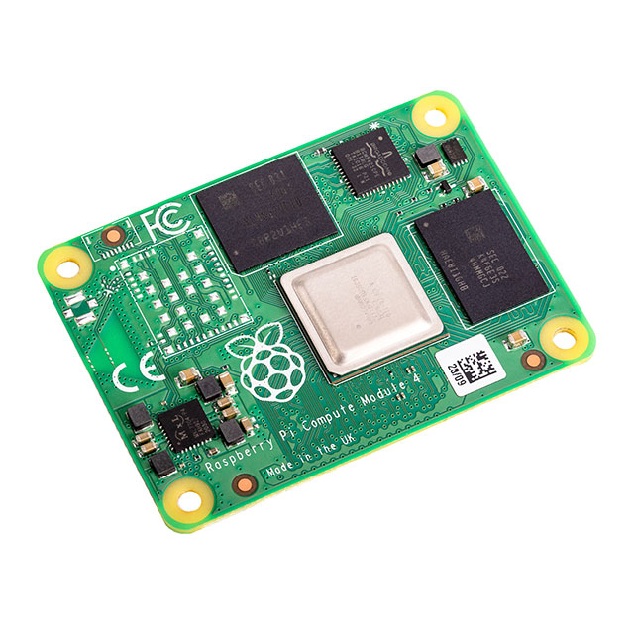
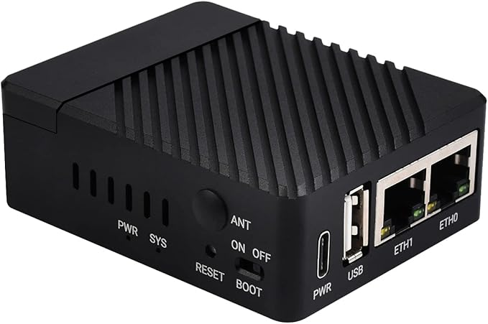
Hardware Considerations
Raspberry Pi Compute Module:
Compact Form Factor
Additional fun options and accessories

Slide 11
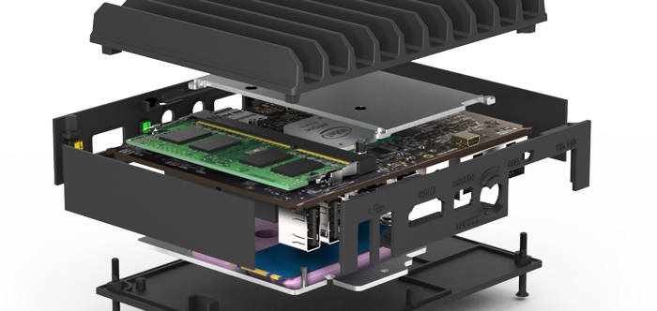
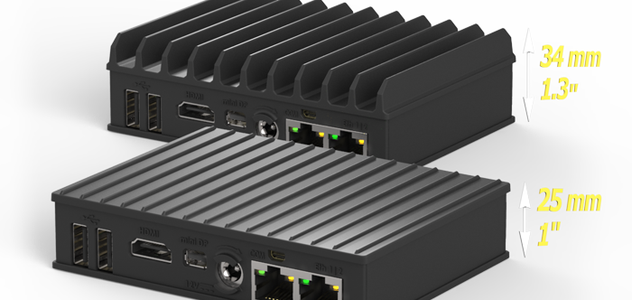
Hardware Considerations
Fitlet (fit-pc.com)
Cheapish
Pocket Sized/Fanless
Intel CPU
Storage/RAM/Comms Options
Dual Ethernet Ports

Slide 12
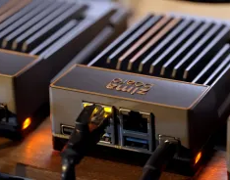
Hardware Considerations
ZimaBoard (zimaspace.com)
Newer but still cheapish
Pocket Sized/Fanless
Intel CPU
Dual Ethernet Ports
-Less communication options
-Fewer user serviceable parts

Slide 13

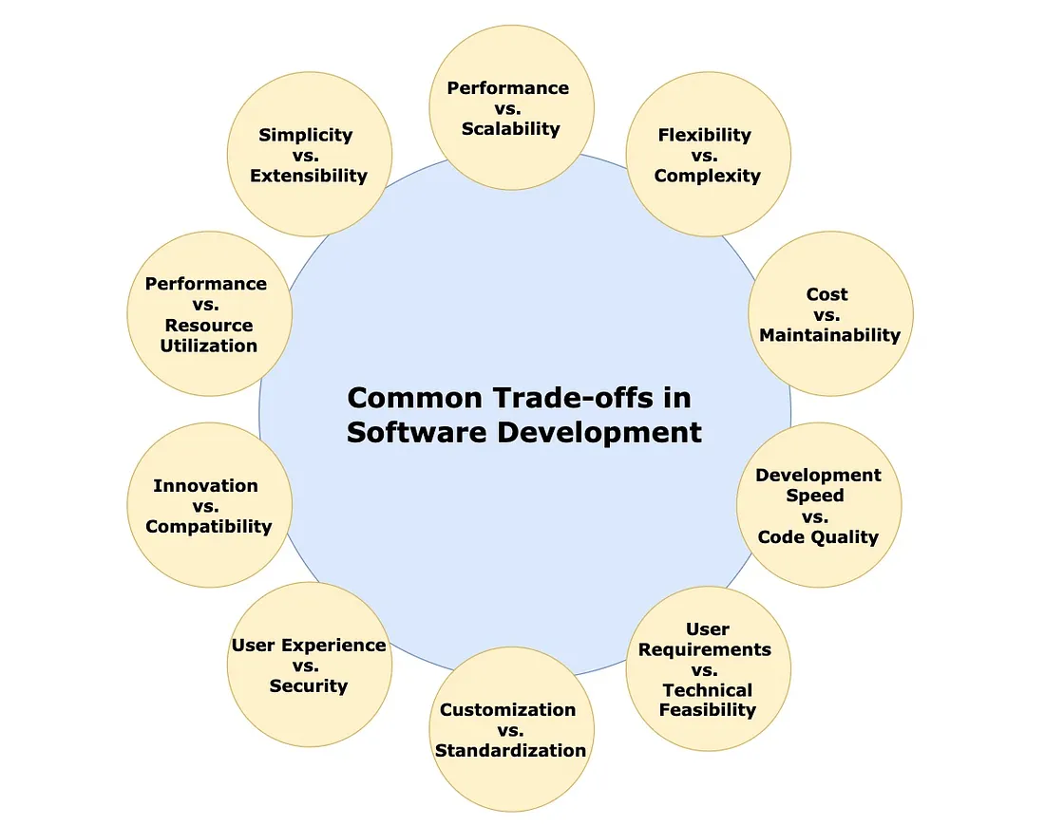
Software Considerations
Goals
Use cases
Restrictions
Ease of Use/Familiarity
Reliability

Slide 14


Software Considerations
Kali/Debian/Raspbian/ Windows?/
Custom persistence scripts
Virtual Machines/ Hypervisor
Wi-Fi Stealth

Slide 15


Software Considerations
OpenVPN/ WireGuard / VPN
Cryptmypi https://github.com/unixabg/cryptmypi
NAC Bypass Scripts
C2 Integrations

Slide 16
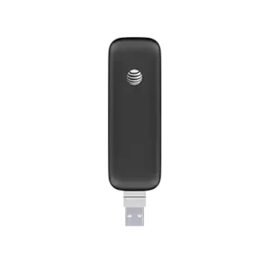
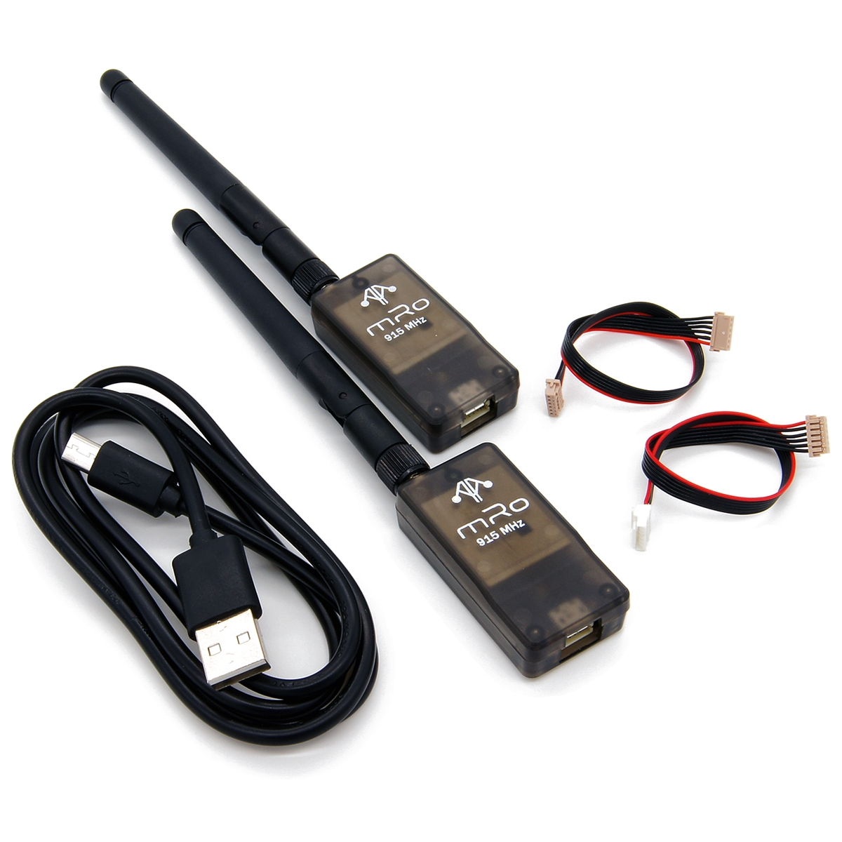
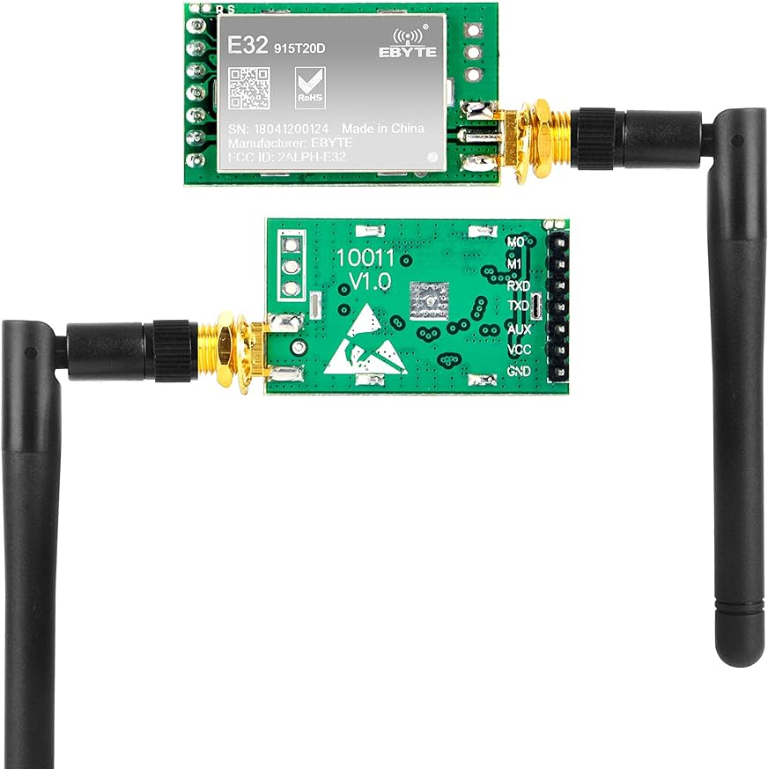
Communication Options / Network Egress
Network Egress
Wi-Fi
Cellular
Bluetooth

Slide 17
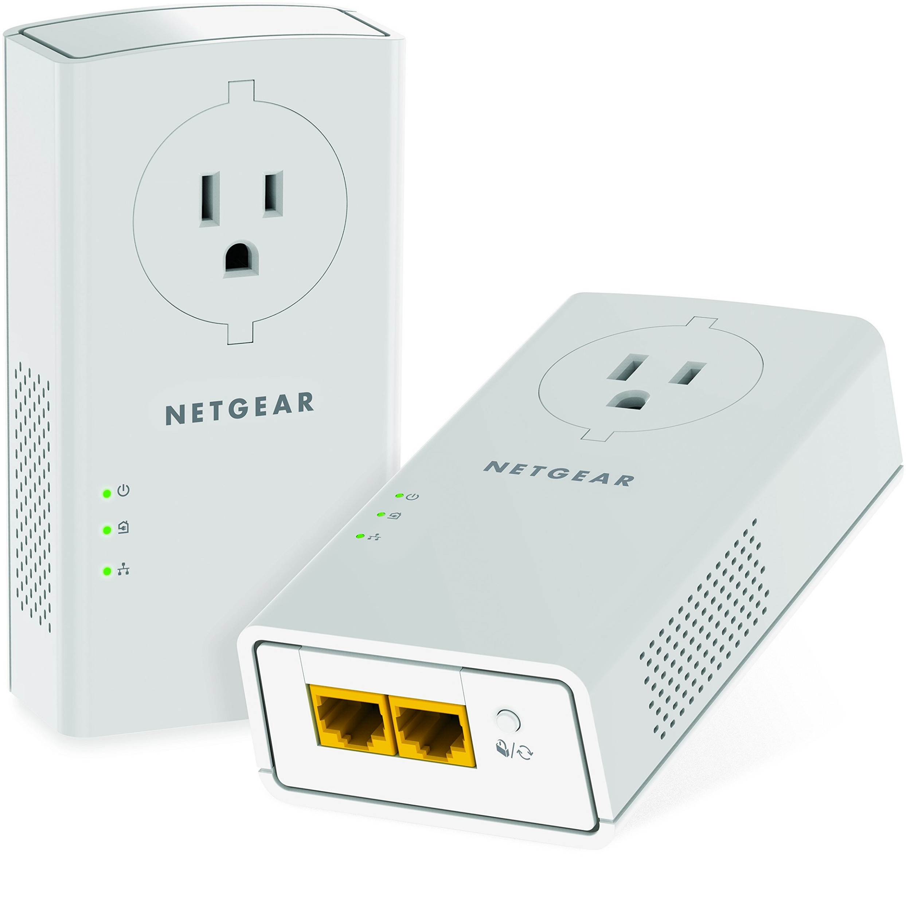
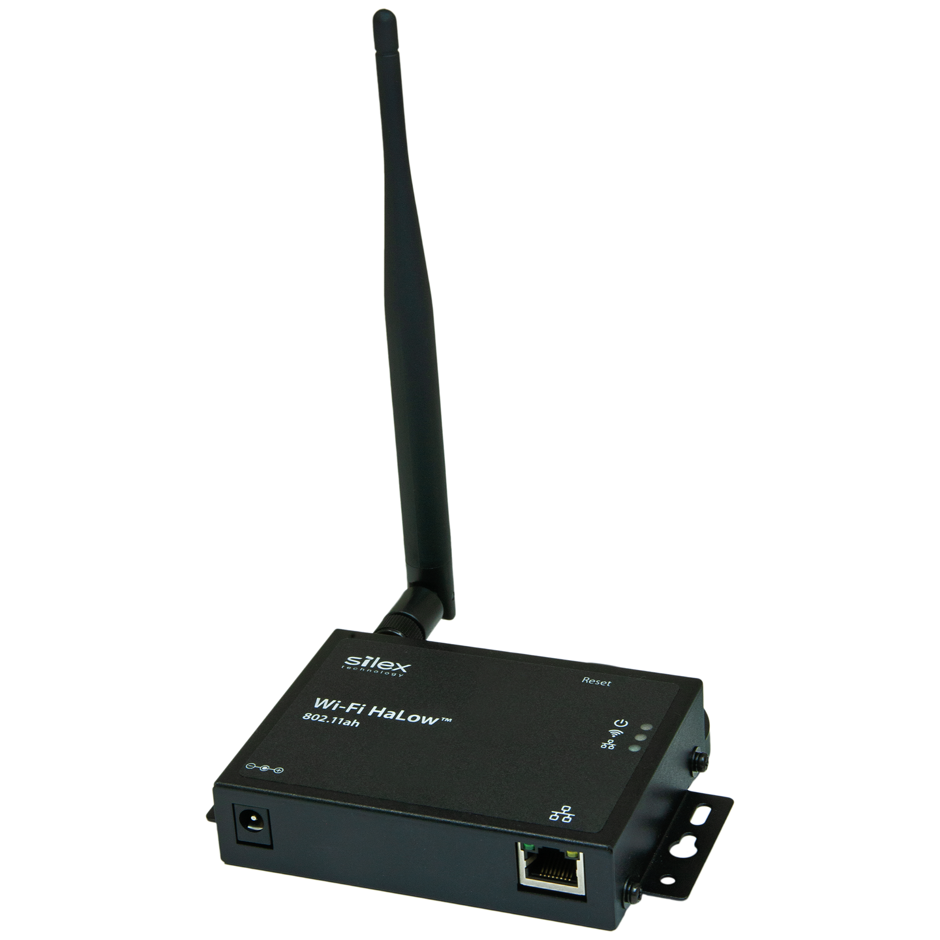
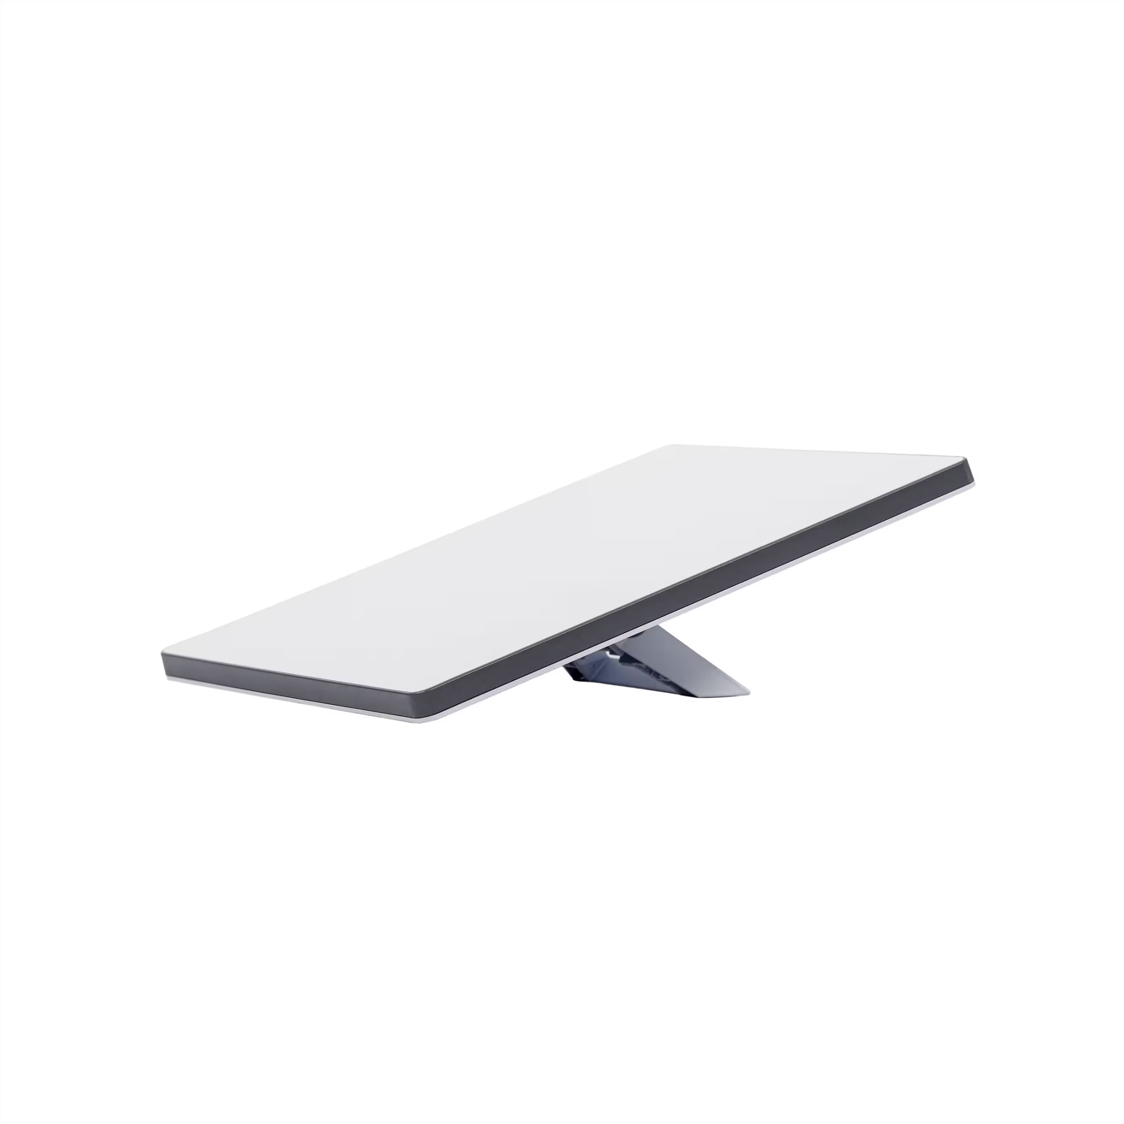
Communication Options / Network Egress
Wi-Fi HALOW (802.11ah) / 900Mhz option
Satellite
Powerline Ethernet
Multimedia over Coax Alliance (MoCA)
Zigbee/Z-wave/etc.

Slide 18
OPSEC
Crime is harder than it looks! (a.k.a. more dumb things I’ve done)

Slide 19
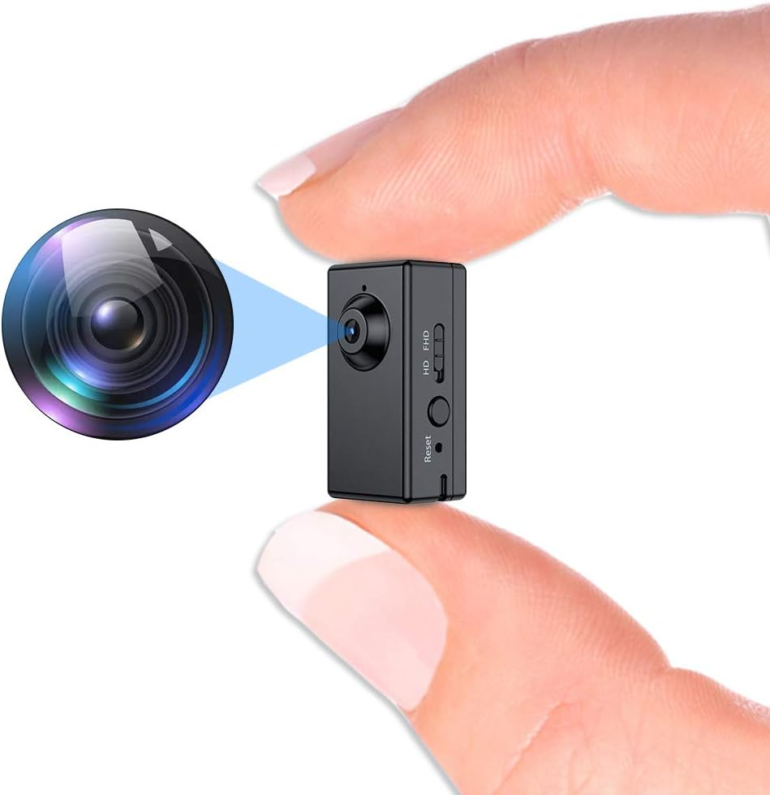
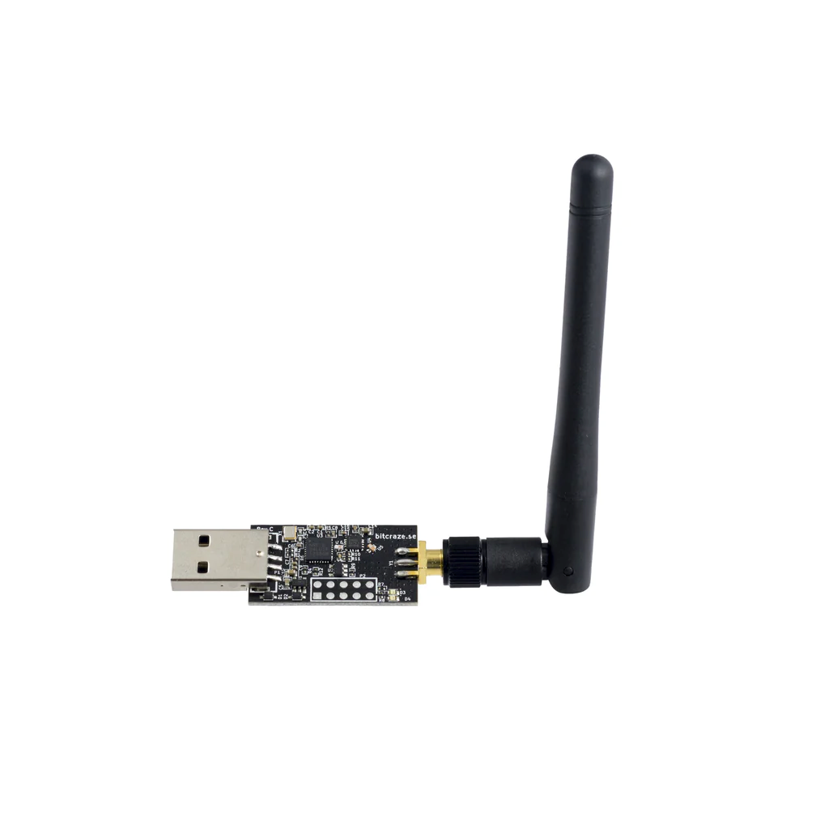

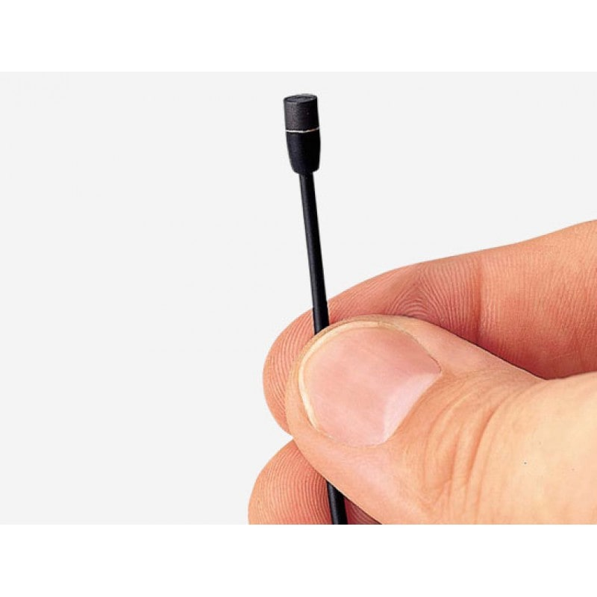

Well, that’s not going to hold up in court.
Audio Recording (Going to Jail?)
Video Recording (Going to HR?)
Wi-Fi /Bluetooth/Wireless HID (Going to break PROD?)
Physical Testing Authorization (Going to be a cautionary tale?)

Slide 20

Recap
What are you testing?
How much can you afford?
What’s your sweet spot for:
Hardware?
Software?
Comms?
Support?
Take the time to test and find problems before the engagement.
Have fun, get creative, be part of a cool story.

Slide 21
THANKS!

Slide 22

Q&A + Future Stuff? + Links/QR
On-Deck
Custom Enclosures
Power Bricks
VOIP Phones
CM Pi Monitors
Minimalist/POE Options
Wi-Fi Only Dropbox
Note, links etc. https://github.com/also-here/DropBoxNote OR the code below

